Slide 1
Jumpman23 New Market Analysis Christie Wang July 2019
Food Delivery Firm
***Please open this presentation in SlideShow mode to allow picture GIFs to play

Slide 2
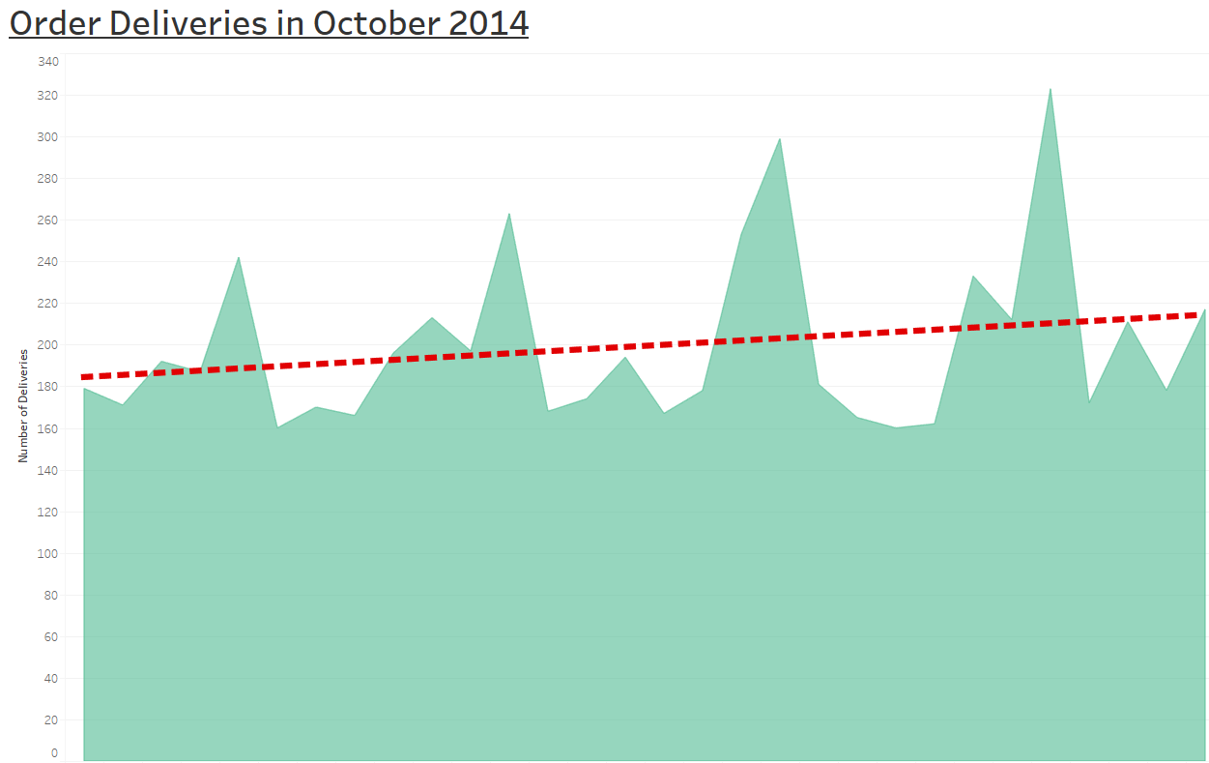
Executive Summary
To evaluate Jumpman23’s performance in New York City, this market analysis is broken down into 3 separate sides of the marketplace: Customers, Merchants, and Jumpmen.
Assumptions:
Define metrics of success as order frequency, as higher number of orders equates to increased revenues
Field “How Long it Took to Order” represents time Jumpan23 took to place the food order.
Field “When Jumpman Left Pickup” – “When Jumpman Arrived at Pickup” = Total Wait Time at Pickup = Parking Time + Waiting for Food Time
There’s a trending 3% linear growth over this one-month time period, which shows consistent and growing demand for Jumpman23!
This growth coupled with the data insights into Customers, Merchants and Jumpmen show that the New York City business is thriving.
Through evaluation, insights, and recommendations for Customers, Merchants, and Jumpmen along with addressing data integrity issues, Jumpman23 can continue to succeed & further thrive in the New York City marketplace
Food Delivery Firm

Slide 3
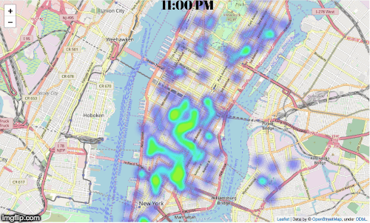
Market Analysis – Customers and Orders
Hourly Compilation of Order Drop-off Locations
Insights:
3,192 customers in New York from this time period:
1,939 customers used the service once (New), 1,253 customers used the service more than once (Returning).
Each customer orders on average 2 times in a month, with single most frequent customer ordering 28 times
Average total delivery time (from time when delivery started to drop off time) is 46 minutes
Average total order time is 8 minutes, however standard deviation of 5 minutes, which signals some divergence between order times
7PM (more broadly 6-8 PM) around Lower Manhattan (under 32nd Street), specifically between 14th street and Franklin Street, seems to be most popular time/location for customer drop-off area
Food Delivery Firm

Slide 4
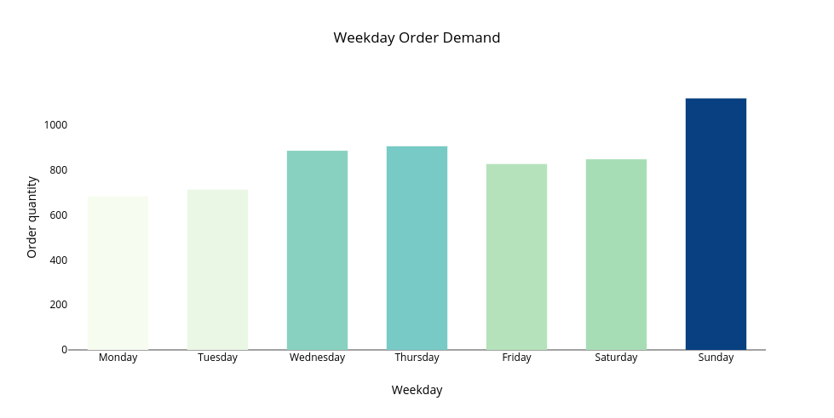
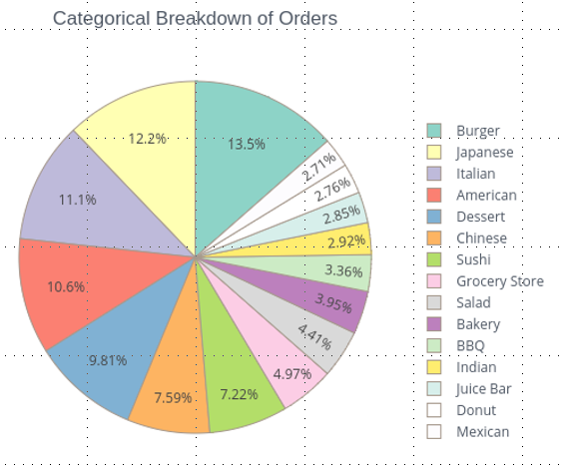
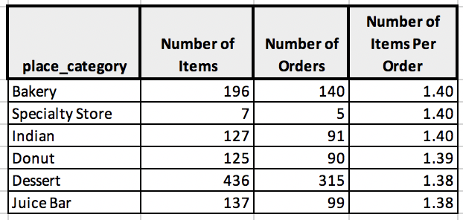
Market Analysis – Customers and Orders
Sunday is the most popular order day of the week.
Jumpman23 receives orders in a cyclical natural during the week throughout the month, whereas weekends consistently outperforms earlier weekdays such as Monday & Tuesday
Customer demand for different food types is fairly even. There is no food type that strongly dominates and no place categories with a significant number of items per order.
Overall, healthy mix of food options and demand for each food category
Evaluation & Recommendation:
There is a strong customer population supporting Jumpman with a sound mix of new and returning customer.
Customer loyalty program to incentivize customers to order more frequently.
Promotions to increase orders on Monday/Tuesday (least popular days of the week)
Advertise popular food categories such as Burgers/Japanese, when doing promotions as that’s what customers desire the most.
Food Delivery Firm

Slide 5
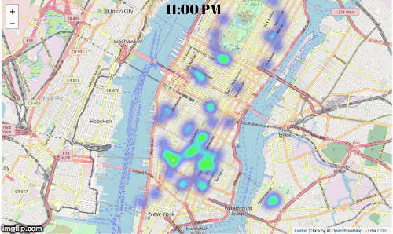
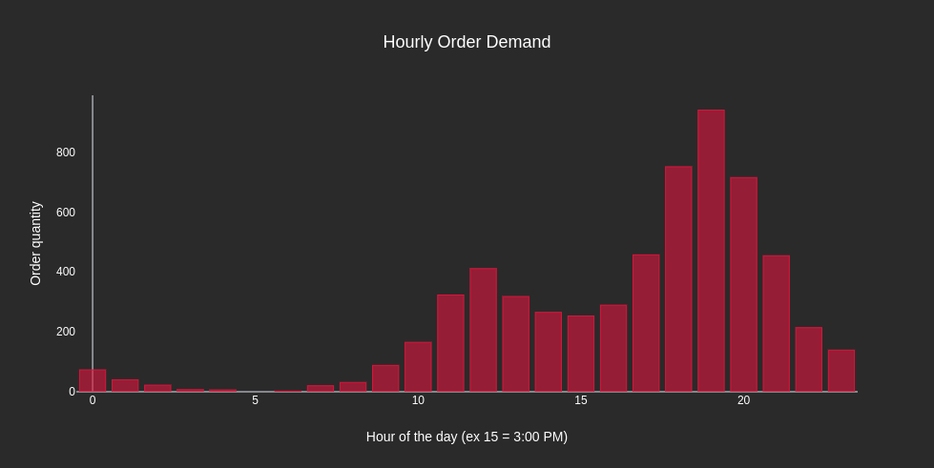
Market Analysis - Merchants
Insights: 896 merchants in New York from this time period
Each merchant receives an average of 7 orders
Merchants located in the Lower East Side Area attracts great popularity between 23rd street and Grand Street.
7 PM, and more broadly 6-8 PM is the most hectic time for order pickups
Hourly Compilation of Order Pick-up Locations
Food Delivery Firm

Slide 6
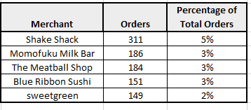
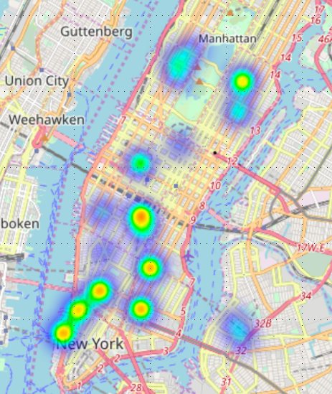
Market Analysis - Merchants
Top 5 Merchant Locations
The Top 5 Merchants are listed to the left and encompass 16% of the total orders received
Evaluation & Recommendation:
There are quite a few Merchants partnered with Jumpman, allowing for customers to get a variety of selection!
Strategically assign Jumpmen to service densely populated merchant pick-up locations especially during times of day with increased demand
Partnership with targeted frequent merchants to facilitate: easier ordering channels (such as an online order communication platform) thus faster order times, increasing overall customer experience satisfaction
Food Delivery Firm

Slide 7
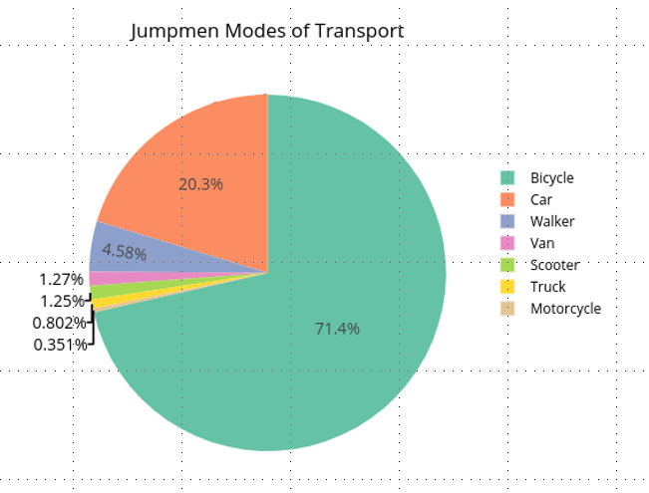
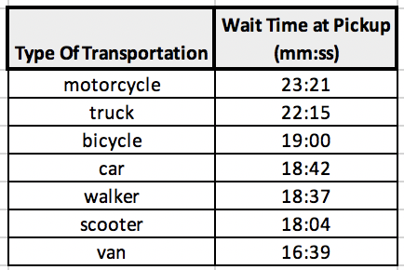
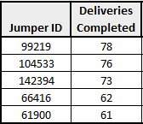
Market Analysis - Jumpmen
Insights: 578 Jumpmen in New York from this time period
Each Jumpman completes an average of 10 deliveries, with the top performing Jumpman completing 78 deliveries!
As Bicycles and Cars are the most frequently used method of transportation, it would help to reduce their average wait time at pickup. This wait time is most likely attributed to the restaurant, rather than the Jumpmen looking for parking as the bikers don’t need parking.
Evaluation & Recommendation:
There is a strong, active Jumpman worker base in New York
Initiate Jumpmen rewards program to incentivize Jumpmen to make more deliveries by awarding any Jumpmen that surpasses total orders delivered thresholds
Provide specific navigation for bikes and non-motor vehicle options in addition to cars!
Food Delivery Firm

Slide 8
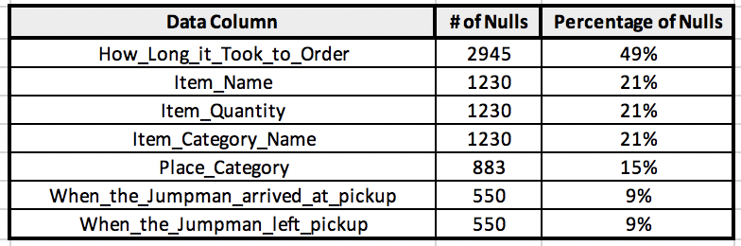
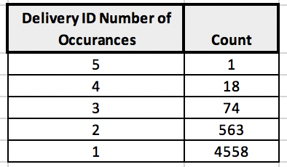
Data Integrity
Data integrity issues for the Jumpman23 data found potentially lead to skewed analytics results and possibly incorrect analysis. Going forward, it’s key that these issues are addressed and resolved.
Findings | Causes | Resolution
Total of 8,618 Nulls found in the data. 49% of total order time column values are null | Data is not correctly being recorded or stored | Better data recording and storage. Requiring that each field be required in the ordering process
Total of 769 duplicate Delivery Job IDs (non-unique). Causes confusion and inability to properly locate a single order delivery | Delivery ID’s are not truly unique. | Instate a mandatory check in order generation process that checks if the delivery ID previously existed
Food Delivery Firm

Slide 9
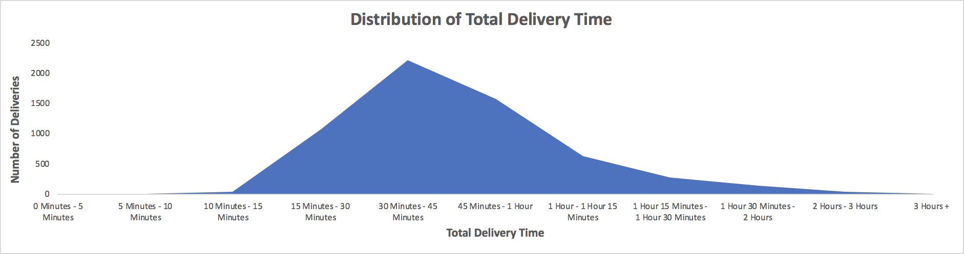
Data Integrity
Data integrity issues for the Jumpman23 data found potentially lead to skewed analytics results and possibly incorrect analysis. Going forward, it’s key that these issues are addressed and resolved.
Findings | Causes | Resolution
501 unique instances where the time Jumpmen arrived at pickup is before the time the delivery started. | Jumpmen already at the location before the delivery started from previous order drop-off Fraudulent reporting of pickup arrival time | Double Check Records Implement automated data validity checks in data pipelining
Certain questionable delivery times are very long (Ex. 5 hour total delivery time) | Order was misplaced or poor data quality
Food Delivery Firm

Slide 10
Final Recommendation
Customer
Jumpman
Merchant
Additional analysis to explore:
Financial data detailing revenues and cost economics gathered to help with profitability analysis.
Time customer initially started order data to better understand total order & delivery time.
Growth Opportunities:
Customer:
Customer loyalty program to incentivize customers to order more frequently.
Promotions to increase orders on Monday/Tuesday (least popular days of the week)
Advertise popular food categories such as Burgers/Japanese, when doing promotions as that’s what customers desire the most.
Merchant:
Strategically assign Jumpmen to service densely populated merchant pick-up locations especially during times of day with increased demand
Partnership with targeted frequent merchants to facilitate: easier ordering channels (such as an online order communication platform) thus faster order times
Advertising opportunities on created online platform to increase visibility of Merchants.
Jumpmen:
Implement Jumpmen rewards program to incentivize Jumpmen to make more deliveries.
The majority of Jumpmen actually utilize Bikes to deliver. Jumpman23 should provide navigation for bikes in specific rather than just for cars!
Maximize Jumpman23’s efforts to always place orders in advance to reduce wait time for Jumpmen reducing total delivery time.
Create logo & merchandise that Jumpmen can wear and utilize to spread brand awareness of Jumpman23
Final Evaluation:
Jumpman23’s New York City exemplifies healthy metrics and growth as shown by analysis of Customer, Merchant and Jumpmen aspects. However, there are multiple data integrity issues that need be addressed. If not, the analysis that can give Jumpman23 a competitive advantage and grow will be incorrect and can possibly even hinder Jumpman23’s growth.
Food Delivery Firm

